Slide 1
Medicare Hospital Management system
Hospital Management system using Apache Tomcat, Eclipse, JSPS, Servlets
Team Members
1.Prajakta Iyer UIN:651510623
2.Sowmya Sankranthi UIN:669431634
3.Kajol Shaikh UIN:674282235

Slide 2
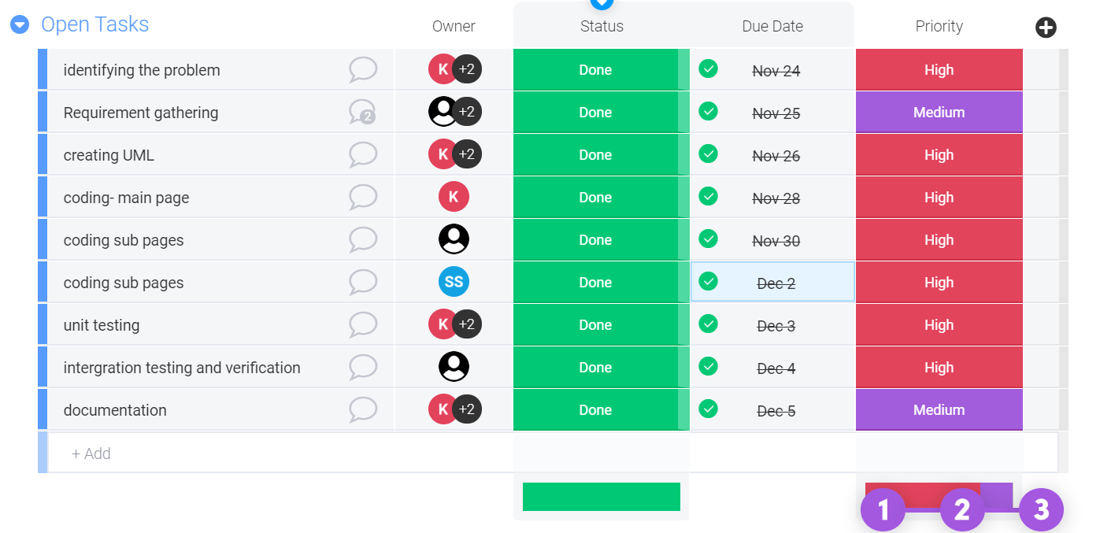
Medicare project scheduling

